Slide 1
Residencia Militar de Estudiantes San Hermenegildo
Hackathon Presentation

Slide 2
Group 10
Alberto Bujalance Muñoz
Álvaro Martín Gordillo
Andrés Villanueva Orgaz

Slide 3
With this Project we are hoping to solve the administration problems at the Residencia Militar de Estudiantes San Hermenejildo, RMESH from now.
The Project consists in the managing of the residence as a means of a web information system
We are aiming to achieve an A grade.

Slide 4
Use Case 1
Use case based on a non-logged user
Enters the web page
Lists the Announcements
Views an announcement

Slide 5
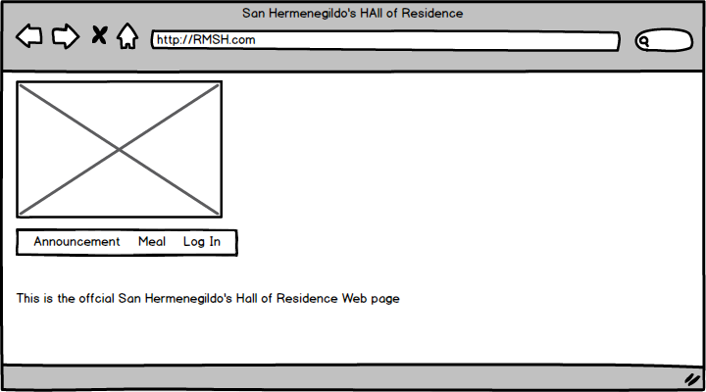
1 Enter the page

Slide 6
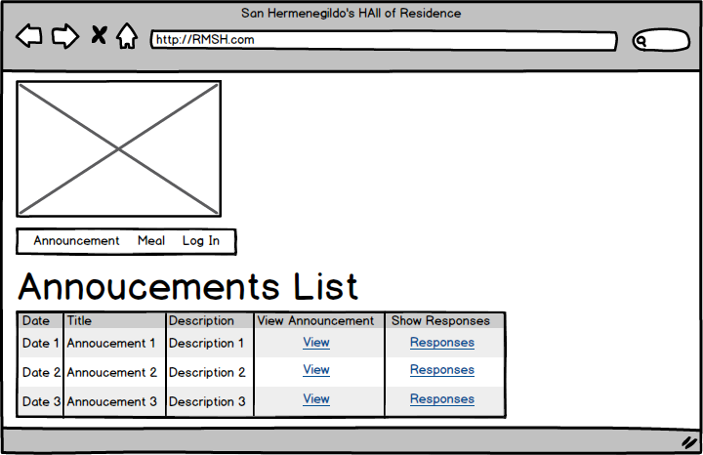
2 List Announcements

Slide 7
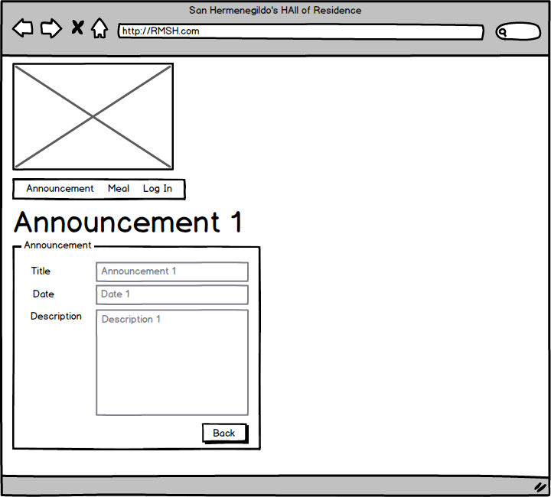
3 View Announcement

Slide 8
Use Case 2
Use case based on a user logged as Resident
A User enters the web page
The User logs in as a Resident
The Resident lists the Announcements
The Resident list the Announcement’s Responses
The Resident creates a Response for the Annuncement
The Resident logs out

Slide 9
1 Enter the page

Slide 10
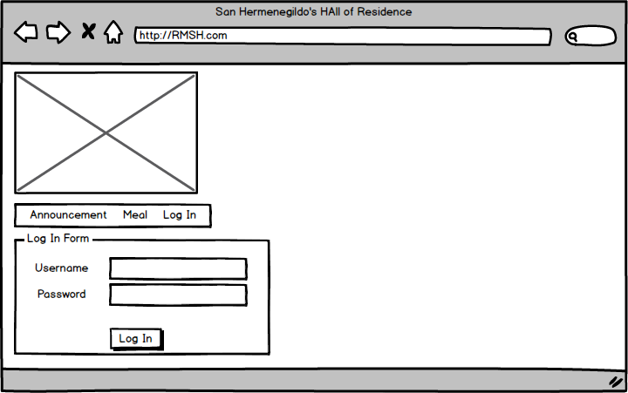
2 Log In

Slide 11
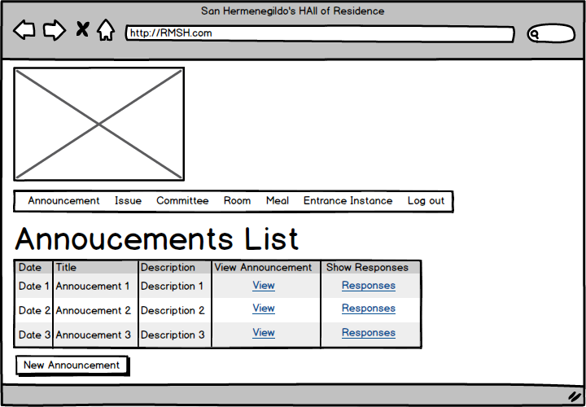
3 List Announcements

Slide 12
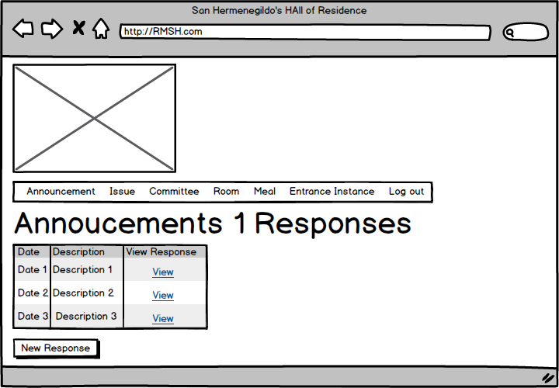
4 List Responses

Slide 13
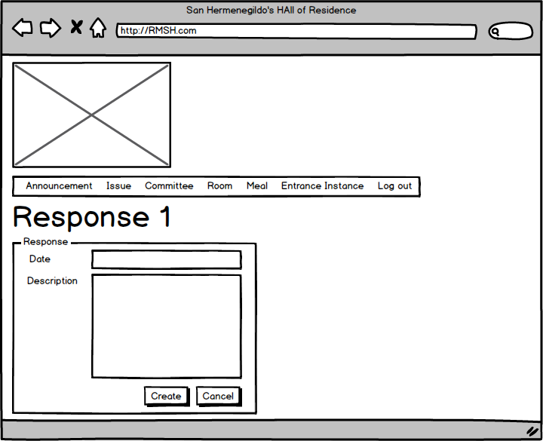
5 Create Response

Slide 14
6 Log Out

Slide 15
Use Case 3
Use case based on a user logged as Administration Personnel
A User enters the web page
The User logs in as a Administration Personnel
The Administration Personnel lists the Residents
The Administration Personnel creates a Resident
The Administration Personnel logs out

Slide 16
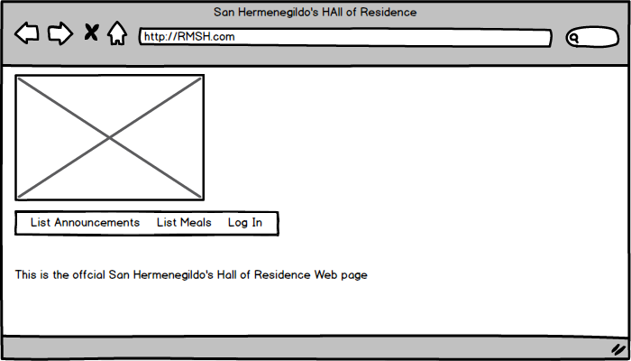
1 Enter the page

Slide 17
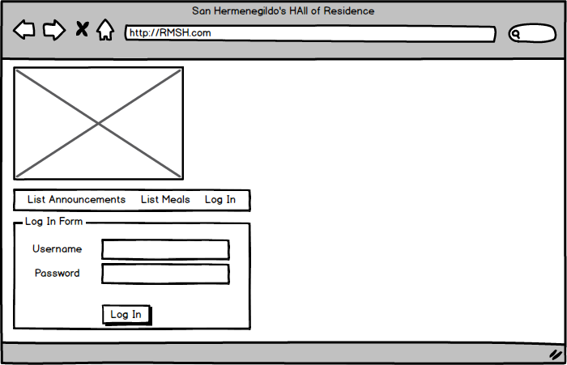
2 Log In

Slide 18
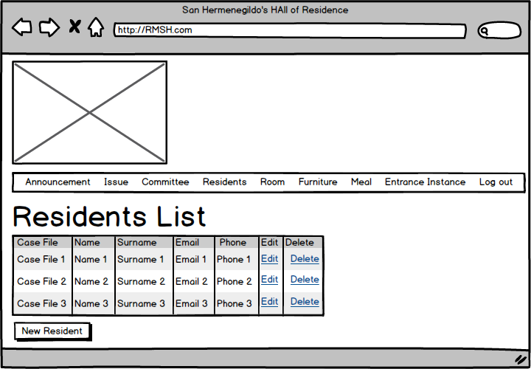
3 List Residents

Slide 19
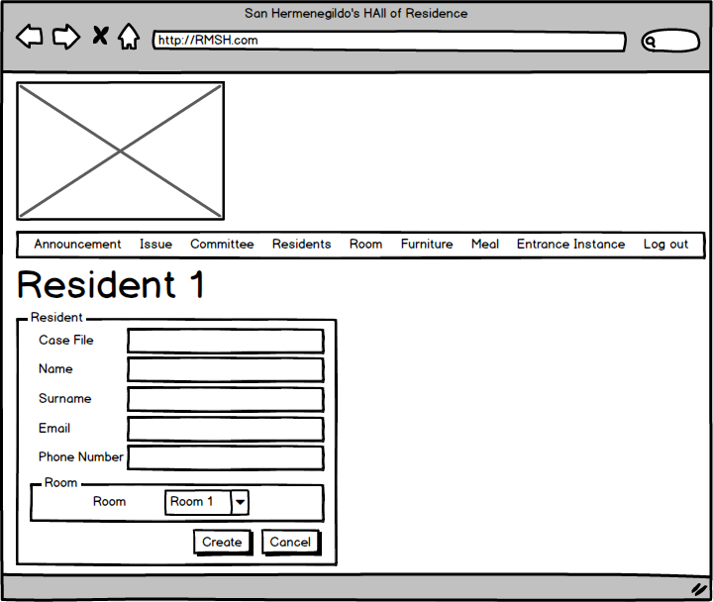
4 Create Resident

Slide 20
5 Log Out

Slide 21
Use Case 4
Use case based on a user logged as Kitchen Personnel
A User enters the web page
The User logs in as a Kitchen Personnel
The Kitchen Personnel lists the Issues
The Kitchen Personnel solves an Issue
The Kitchen Personnel logs out

Slide 22
1 Enter the page

Slide 23
2 Log In

Slide 24
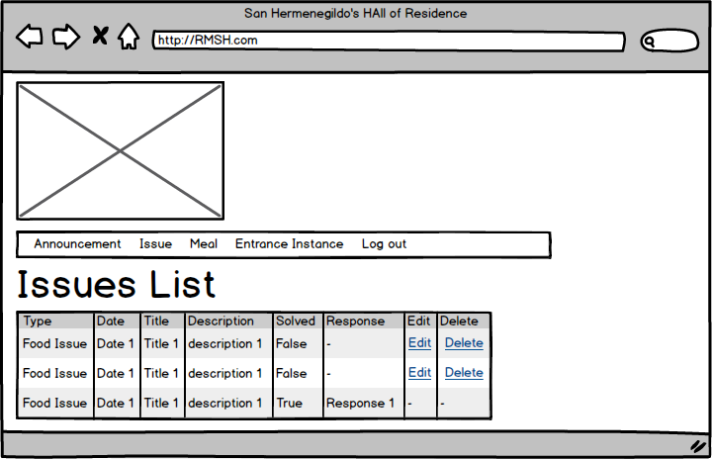
3 List Issues

Slide 25
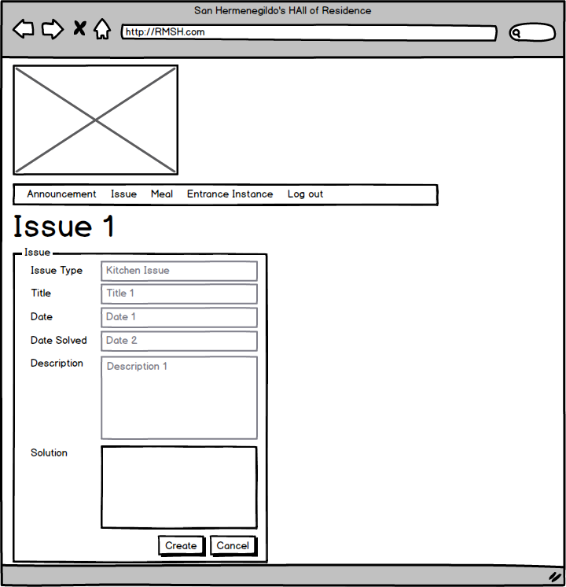
4 Solve Issue

Slide 26
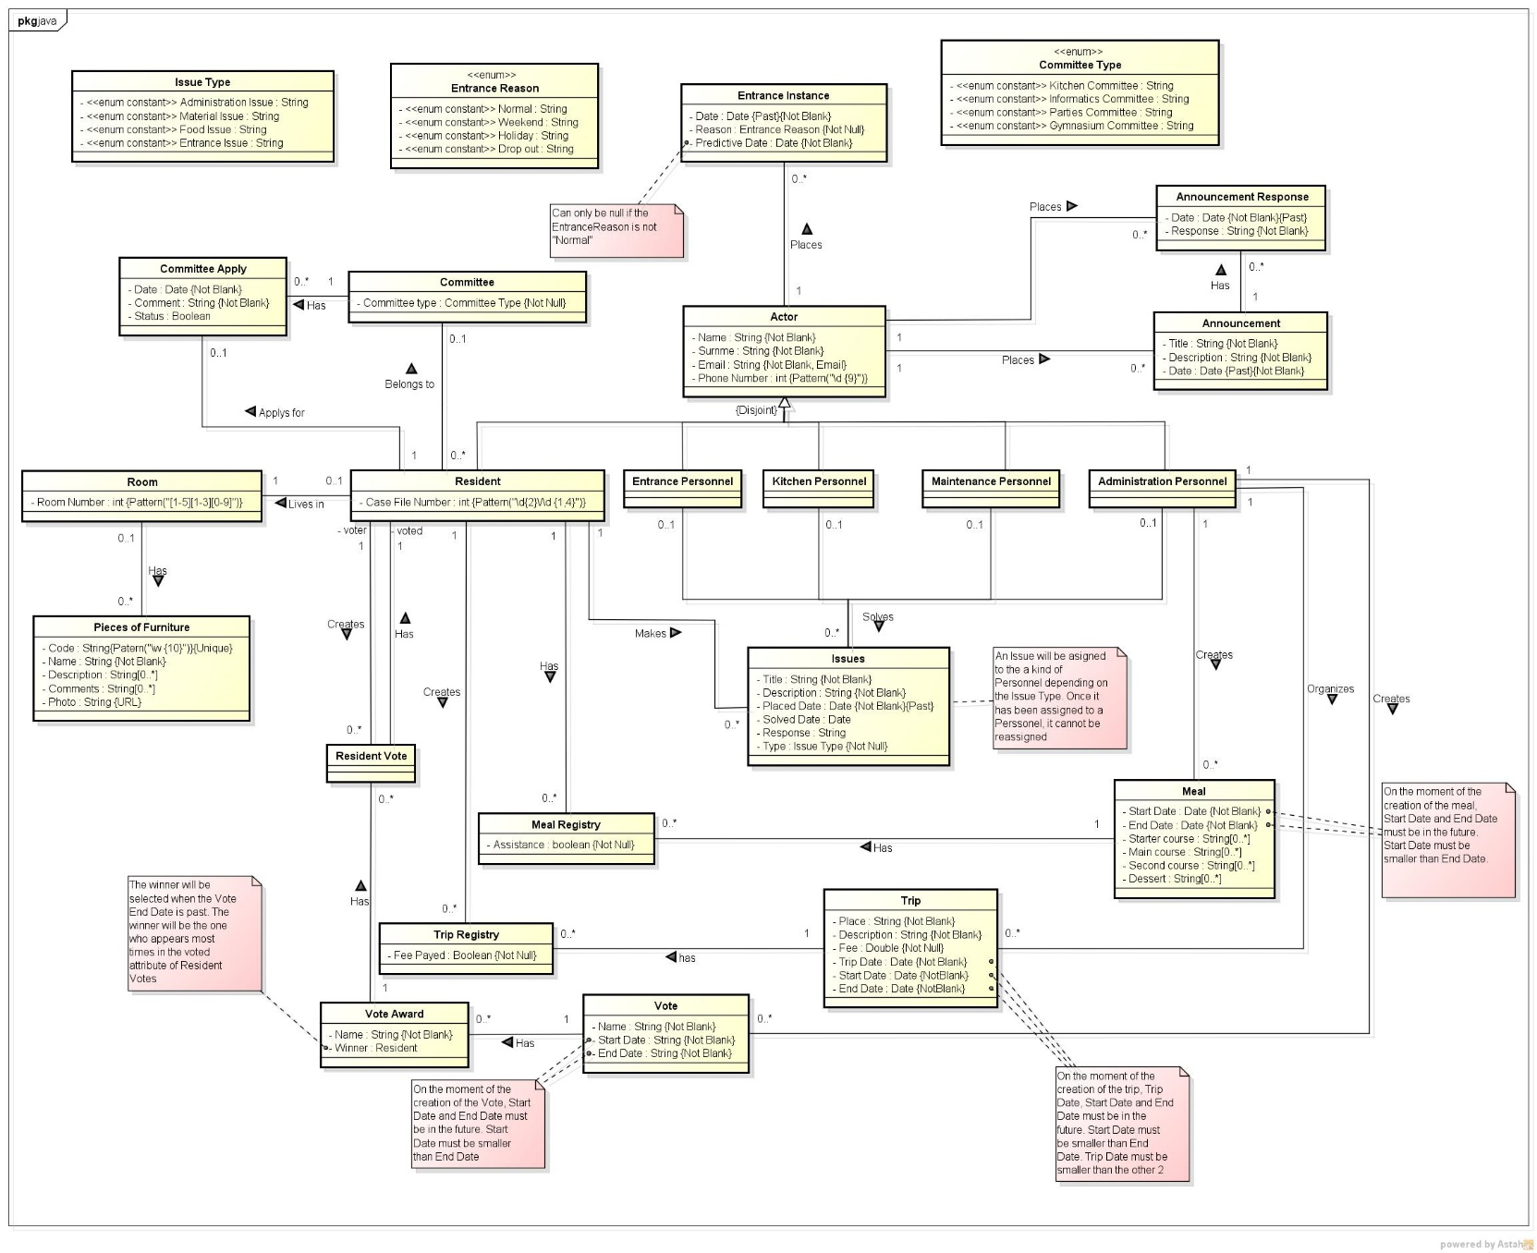
Our projected concept diagram

Slide 27
For the A+
To get an A+ we aim to use Qtip2
Qtip2 is a web site plug-in written on JavaScript, which uses JQuery to place small pop-up panels on the web objects to show additional information about the object, or simply add an image, a URL or any other HTML object. This powerful plug-in allows the user to customize almost every feature, from the colour and shape of the tooltips to the content or the browser in which it will be used.
For more information see qtip2 webpage or qtip2 demos webpage

